Slide 1

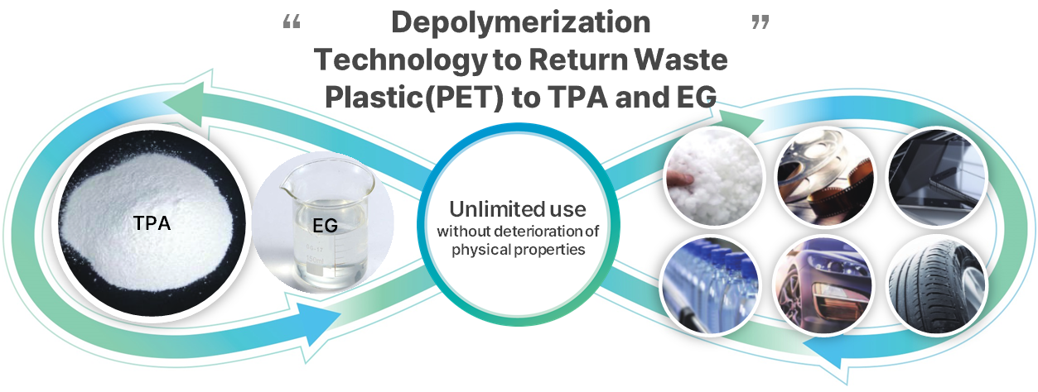
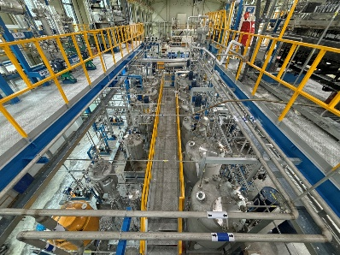
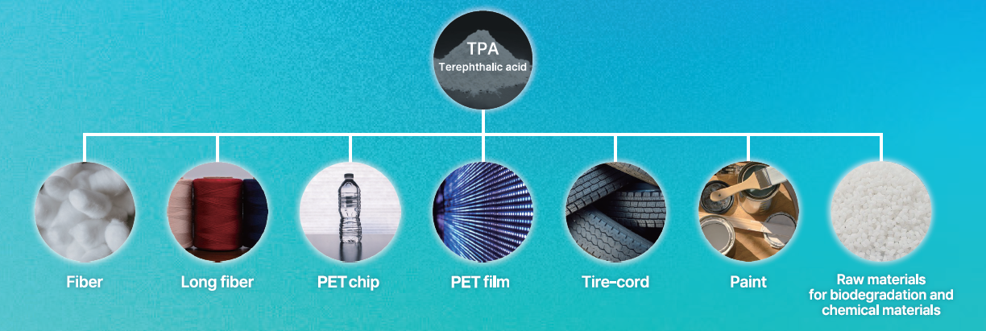
Terracle
Documents (IR deck)
Logo
Terracle is transforming plastic waste into high-purity raw materials, driving a sustainable future through Chemical recycling.
Information
Fundraising plans/Financials
Founded | 2021 | HQ | Busan, South Korea
Business | Chemical recycling / Waste plastic
Executives | 3 / 21
Value/Stage /No. of Employees | US$ 41M / Series A / 21
Seed – US $ 334,373 (21-22’)
Series A – US $ 7.8M (24’)
Series B – 25’ 1Q
Current revenue - US $ 473,000 (~ 24’)
Terracle’s automatic pilot factory
Showcase startup’s solution
Service/Product/Business Model
Founders/Team
Explanation of the core business and solution
We focus on chemically recycling PET through a process known as depolymerization, turning it back into its raw materials, TPA (terephthalic acid) and EG (ethylene glycol). These materials are then sold to chemical manufacturers, and the plastic products made from our TPA and EG are classified as 'recycled plastic.’
What is the competitive edge of your solutions
Our competitive advantage lies in our technological expertise and mass production capability. While depolymerization has been an established technology, we are the first to succeed in mass-producing recycled TPA. We currently produce 1 ton per day, and we are in the process of constructing a new plant with a capacity of 10 tons per day.
Use cases and business traction
Terracle began by supplying high-quality TPA for electronic films, marking our entry into the market. Since then, we have expanded our partnerships to a wide range of industries, including collaboration with Hyundai Motors for automotive parts. Additionally, we are actively working with companies in sectors like clothing, cosmetics packaging, and other consumer goods industries, demonstrating the versatility and broad applicability of our recycled TPA and EG products.
CEO - Speaker at 7 Environmental Tech. seminars / Awards in environmental competitions
CTO - Dr. chemistry at Korea Uni.
- Development of new materials and 3 cases of commercialization
Lawyer – Bachelor’s in BA at Seoul Uni. And graduate of the Law school
Number of employees ( 21 )
Traction
We are undertaking projects to supply recycled materials to the film, textile, food, automotive, paint, and electronics sectors. Additionally, we assist clients in establishing closed-loop systems for each product category by recycling production waste or other designated waste streams
We are currently building an automated plant capable of recycling 10 tons per day
Investment Team’s Opinion
Strong and well-known team who bring together scientific expertise and startup operation/scale-up. Strategic potential to work with Materials Center on applications beyond CCUS
Website: [www.terracle.im]

Slide 2


Example
Startup Sample
Documents (IR deck)
StartupSample develops a novel tech for finding materials to converting carbon emissions into useful products
Information
Fundraising Plans / Financials
Founded | March, 2021 | HQ | Lisbon, Portugal
Business | CCUS
Executives | Joe Allen (CEO, Co-founder) John Smit (CTO)
Value/Stage /No. of Employees | Seed
Completed seed round of $10M in 2021 (Notable investors include HMC, LG)
Currently raising Pre-A with $50M ongoing due to interest from leading players
Revenue: $1.5M (2023’), EBIT: $20k(2023’)
Showcase of StartupSample’s solution
Service/Product/Business Model
Founders/Team
StartupSample is developing an end-to-end materials design engine that incorporates state-of-the art AI models to deliver materials for CCUS applications
The first use cases of StartupSample in the next 12 months is for the 1. Carbon Capture market – finding right materials for the design of new membranes for CO2 capture
StartupSample plans to find materials that can utilize their novel tech to convert carbon emission easily into products that can be used. StartupSample’s novel solution consists of several technologies:
  Proprietary generative AI, simulation, optimisation and distributed computing techniques
  Enables end-to-end design across a range of applications including climate, chemicals
WHY Coporates SHOULD CARE: StartupSample has the potential to drastically reduce the time and costs utilize to search for CCUS solutions by leveraging on their proprietary tech and labs which focus on CCUS and beyond
Joe Allen (CEO, Co-founder)
Distinguished Scientist
ex-VP at Meta
Founder of Startup1 (acquired by Meta)
Prof. John Smith (CTO, Co-founder)
Founder of Tint (acquired by Google)
H-index : 178
Team of 22 people ranging from senior researchers, sales and commercial experts in the carbon capture industry
Traction
Over 30 LOIs with industry leaders in energy market
On track to complete a 50MW scale project in Japan
HMC Investment Team Opinion
Strong and well-known team who bring together scientific expertise and startup operation/scale-up. Strategic potential to work with different teams on applications beyond CCUS
Website: [startupsample.com]

